Slide 1

21st Century nuclear energy-you are in charge of creating it
January 31 2018, Todd Allen

Slide 2
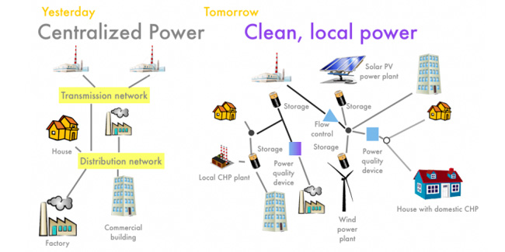
The Energy System
www.mysolarhome.com

Slide 3
“markets”-Rent Seeking Opportunities Galore and who are your customers
Electricity Supply
Capacity
Ancillary Services
Minimum Offer Price Rules
Energy Imbalance Markets
Demand Response
Process Heat
Federal Tax Credits
State Renewable or Clean Energy Mandates or other Dictates (and associated negative pricing)
Carbon price
Power Purchase Agreements
Suggesting Reading:
https://americanaffairsjournal.org/2017/05/no-free-market-electricity-can-ever/

Slide 4
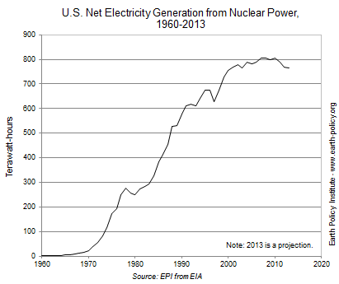
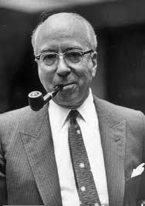
Confident Experts
Lewis Strauss
“It is not too much to expect that our children will enjoy in their homes electrical energy too cheap to meter, will know of great periodic regional famines in the world only as matters of history, will travel effortlessly over the seas and under them and through the air with a minimum of danger and at great speeds, and will experience a lifespan far longer than ours as disease yields and man comes to understand what causes him to age.”
Scientiﬁc and technical advances bring unquestioned beneﬁts, but they also generate new uncertainties and failures, with the result that doubt continually undermines knowledge, and unforeseen consequences confound faith in progress.
Sheila Jasanoff, in “Technologies of Humility”, 2003
http://www.earth-policy.org/plan_b_updates/2013/update116

Slide 5
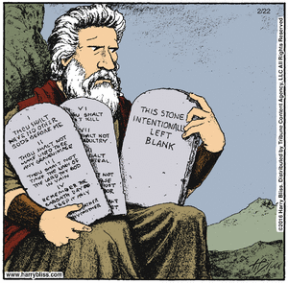
Image of Nuclear energy creativity

Slide 6
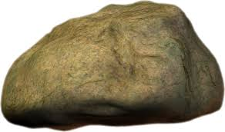
What do these have in common?

Slide 7
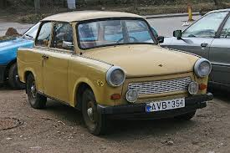
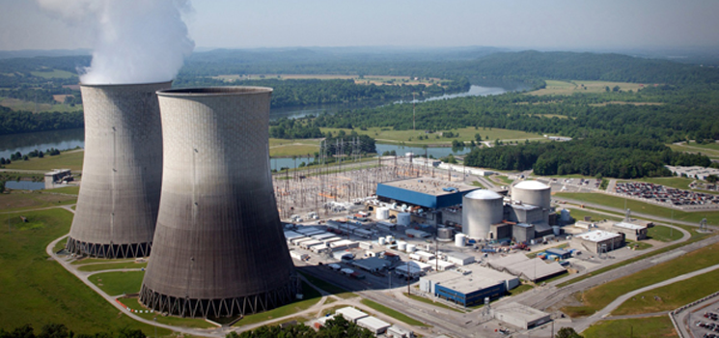
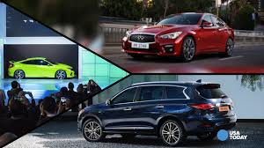
Nuclear products
Gigawatt-scale electricity
Soviet Trabant
The customer won’t buy your Trabant if they can buy a Camry
Detroit Auto Show

Slide 8

Quotes from Advanced energy April 2016
Focus on NY Reforming the Energy Vision. :
    REV and the announced $150M Green Bank must:
      Transform while protecting jobs to support people (e.g., fossil jobs become solar jobs)
      Incredible ideas coming out of the university community
      Need wave after wave of demo projects
      Community led projects
      All New Yorkers must participate. This must support low and moderate income families
      Resilience is a foundation
      Start with the customer
      Think Big. Start Small. Scale Fast.
Thinkstock

Slide 9
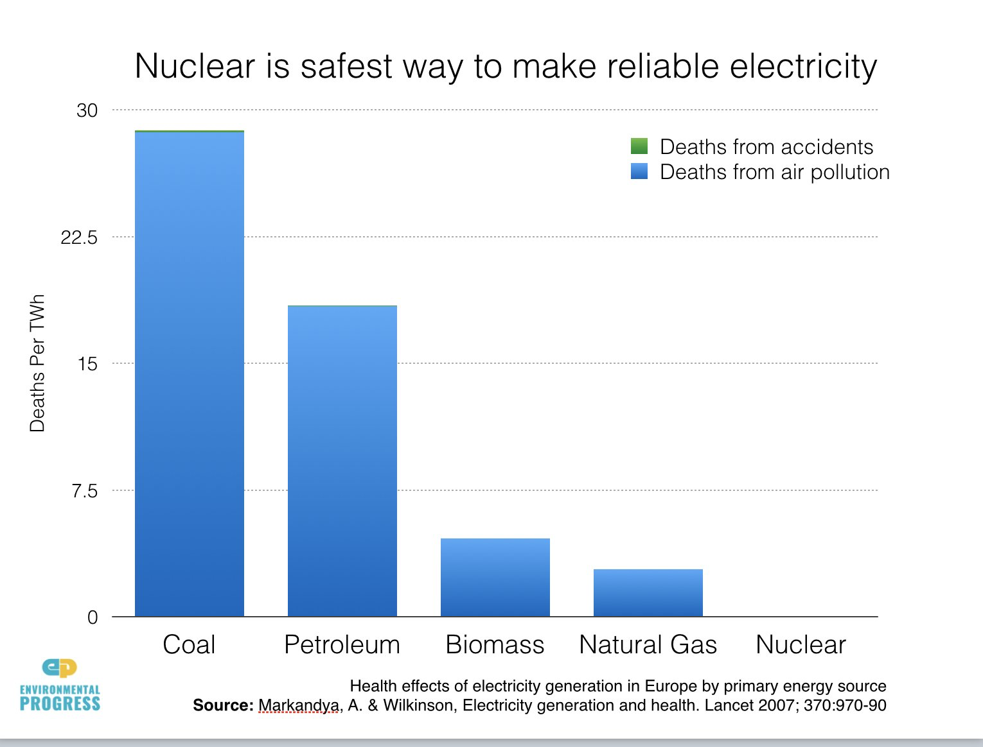
Why nuclear engineers like nuclear
“We kill less people than you think”

Slide 10

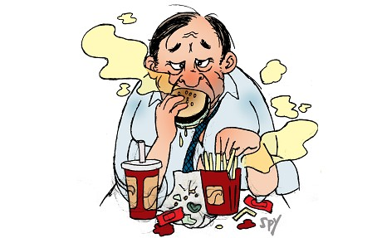
Proposing marriage
Would you try the Following? Please be my spouse because compared to your last offer, I am:
      Not as Dumb
      Not as Cheap
      Not as Ugly
      Not as Smelly
If no, then why talk about your new nuclear technology as:
      Not as Dangerous
      Not as Expensive
      Not such a Big Waste Problem
      Not as Big a Proliferation Risk

Slide 11
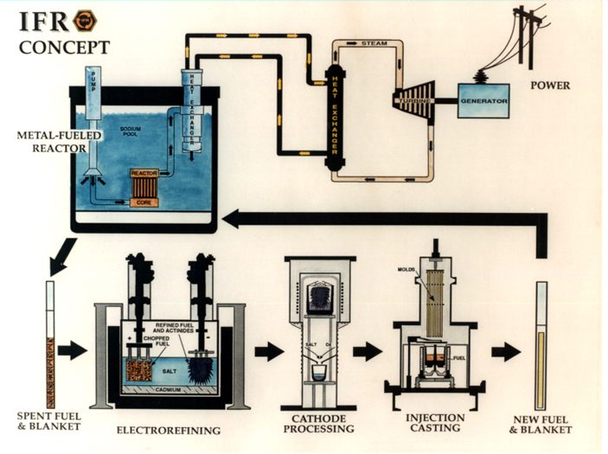
The Product Must Make Sense
Before its time?

Slide 12
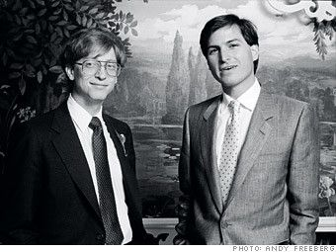
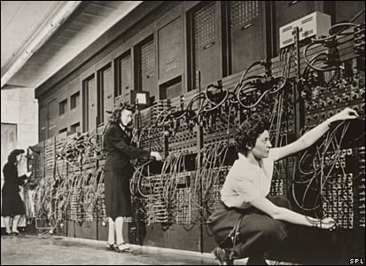
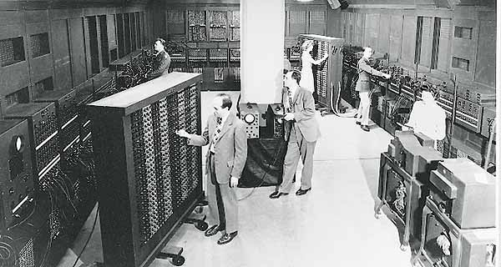
Personal Computers
Before the introduction of the microprocessor in the early 1970s, computers were generally large, costly systems owned by large corporations, universities, government agencies, and similar-sized institutions. End users generally did not directly interact with the machine, but instead would prepare tasks for the computer on off-line equipment, such as card punches.
A different model of computer use was foreshadowed by the way in which early, pre-commercial, experimental computers were used, where one user had exclusive use of a processor.
From: Wikipedia

Slide 13
Designer Fuels and Materials
Prevalent kinds of semiconductors
Comparators
Audio Processor Circuits
UV Erasers
Frequency Control Circuits
Data Converters
Discrete Semiconductors
Display Drivers
Interface ICs
Memory Chips
Power Management ICs
Microcontrollers
Logic Circuits
Radio Frequency Circuits
Sensor ICs
Standard Logic
Video Processor Circuits
Designer Fuels
Actinide burner
Isotope production
Power production
Designer Material
Corrosion barrier
High rad, low temp
High rad, intermediate temp
SCC resistant

Slide 14
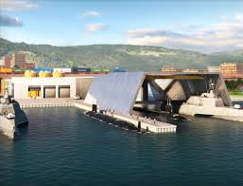
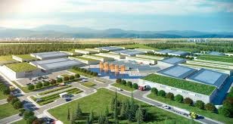
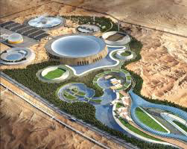
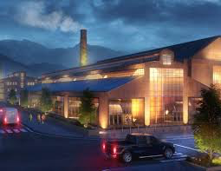
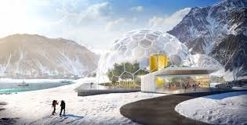
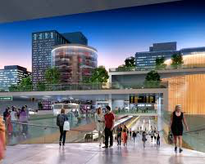
Nuclear reimagined

Slide 15
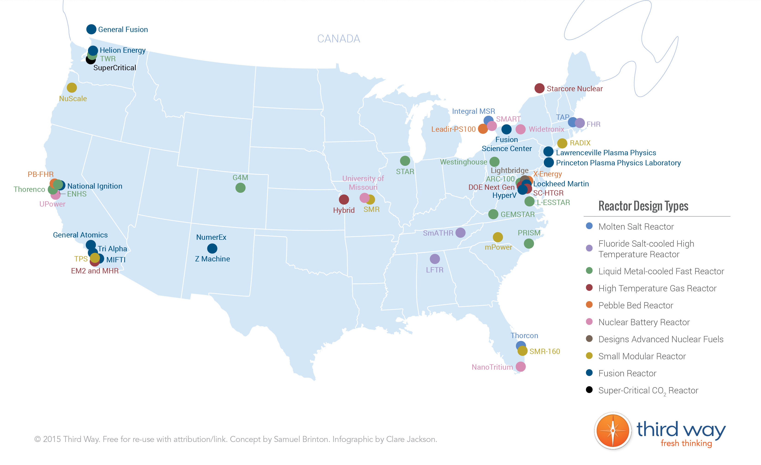
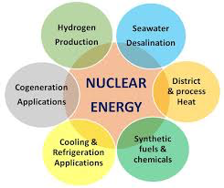
The Advanced Nuclear Industry
~50 companies
~$1.5B of private capital

Slide 16
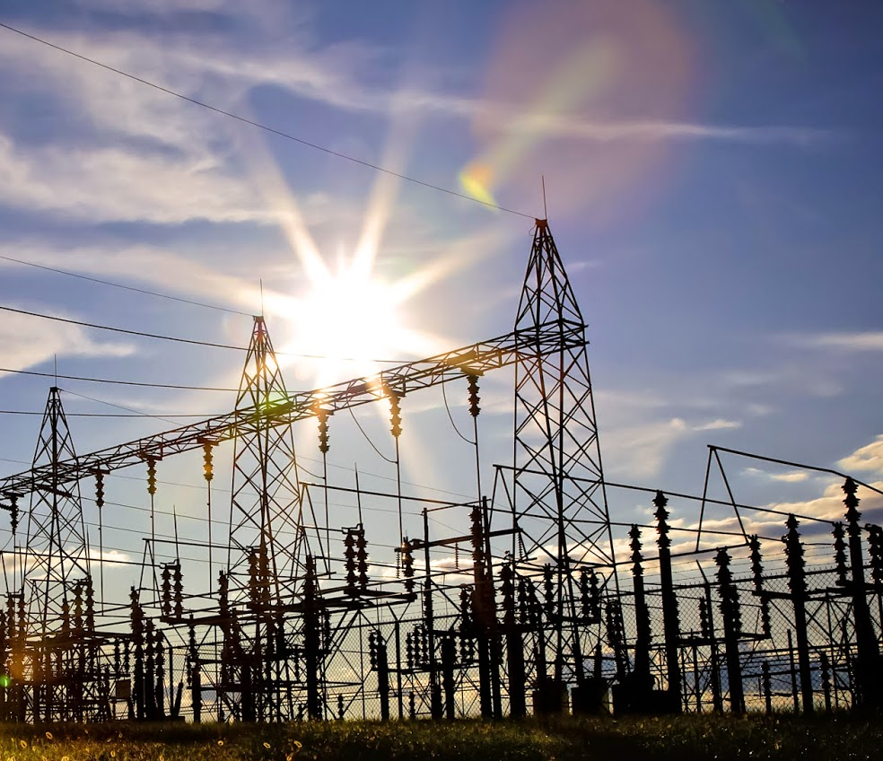
Modern Grid-Systems View (NETL Report)
The modern grid:
Self-heals
Motivates and Includes the consumer
Resists attack
Provides power quality for 21st century needs
Accommodates all generation and storage options
Enables markets
Optimizes assets and operates efficiently
Using:
Integrated Communications
Sensing & Measurement
Advanced Components
Advanced Control Methods
Improved Interfaces and Decision Support

Slide 17
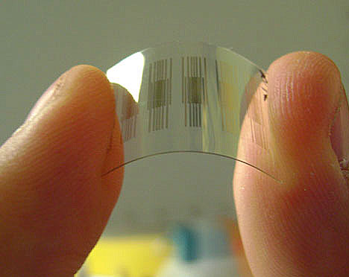
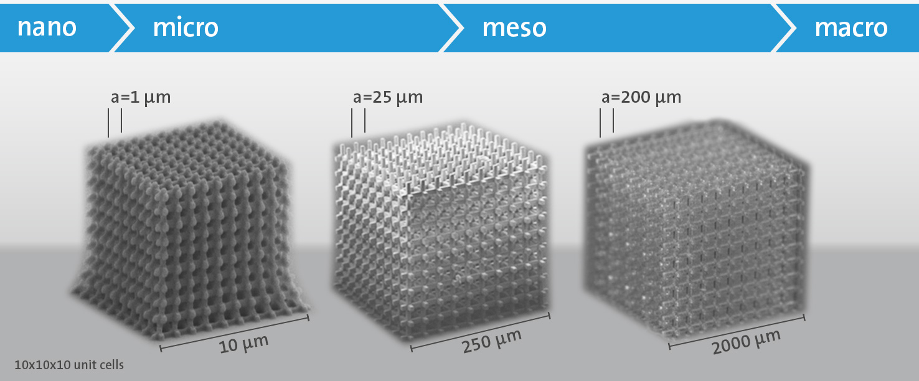
Self-heals
Probabilistic risk assessment or RISMC tools to understand highest probable failure mechanisms
Design at the concept/fuel level for flexible performance to mitigate undesirable system conditions
Develop nano-sensors that provide pervasive sensing to reduce uncertainty margins

Slide 18
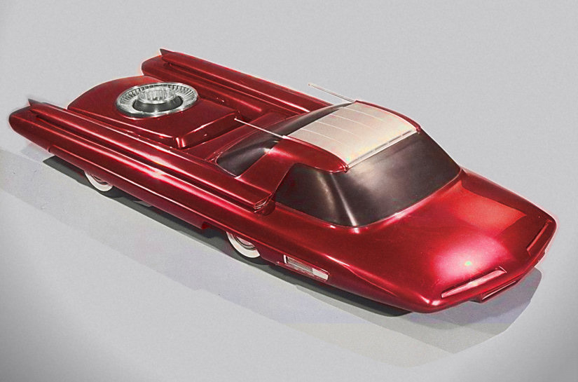

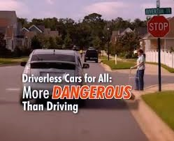
Motivates and includes the customer
Customer ownership of their energy (tiny reactors, consumer electronics, clean energy demand, too cool to ignore, betavoltaic devices-nanomanufacturing to remove heat, art to bring the public into the conversation)
Ford Nucleon
The Kempten hydroelectric power station at dusk, Kempten, Bavaria, Germany
Autonomous Reactors

Slide 19
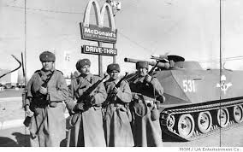
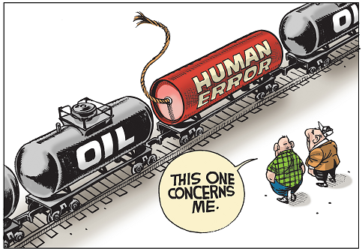
Resists Attack
Simplify design to resist cyber attack
PRA/RISMC to understand vulnerabilities
Human factors

Slide 20

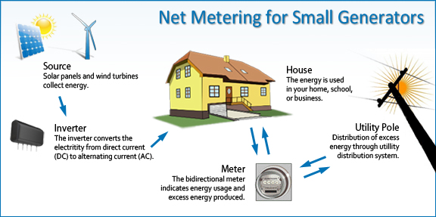
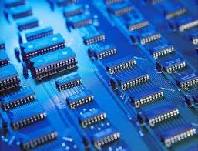
Accommodate all generation and storage options
Commercial users supplying their own power
Nuclear “battery” for grid stability
Need rapid product development (code case time reduction)
Can we take more advantage of direct energy capture?
Requires much more innovation in fuel (each fuel pellet has a function like with semi-conductors)

Slide 21
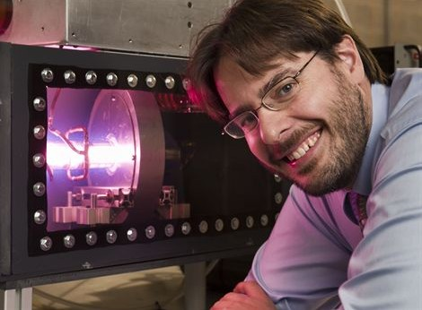
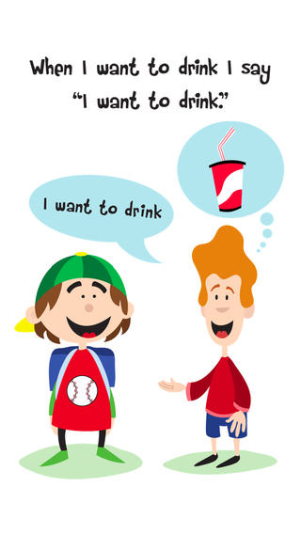
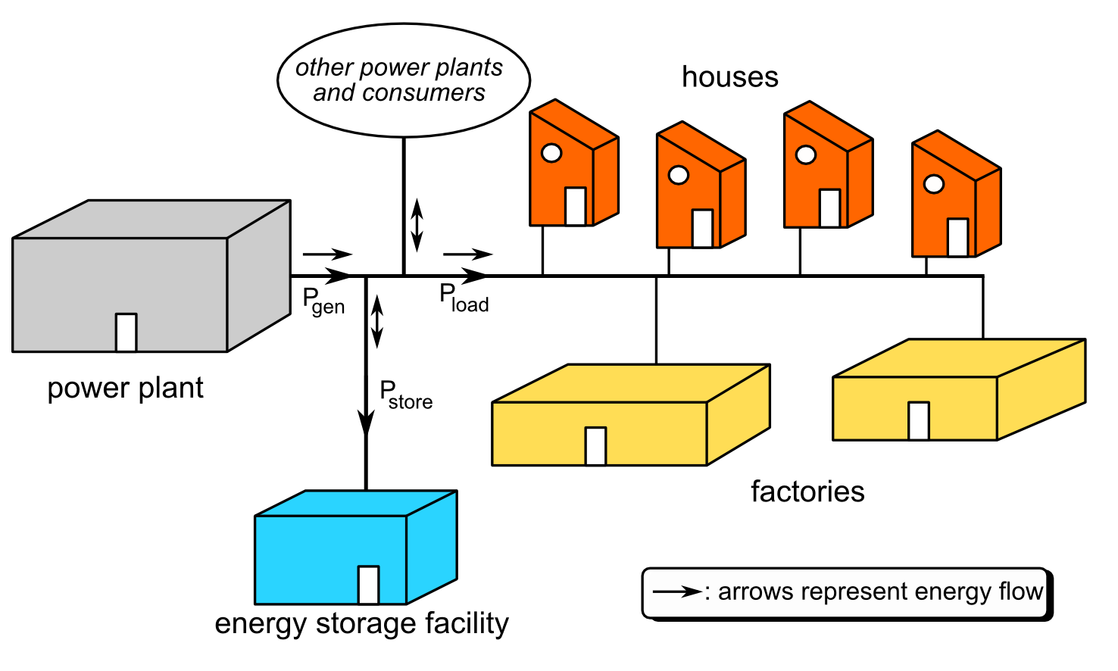
Enables Markets
Possibility for a large range of energy production and storage options
Rush Hour Rewards (RHR) (from NEST) helps people earn money or credits from their energy providers by using less energy when everyone else is using more. Could there be an “I demand nuclear app”
SHINE

Slide 22
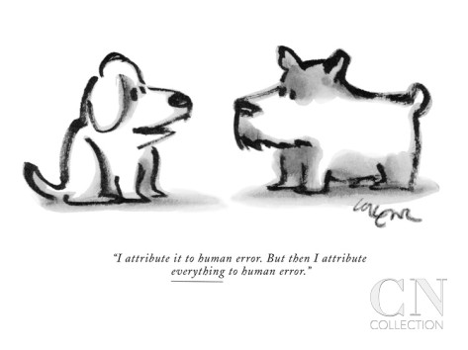

Optimizes Assets
Component degradation models, equipment operation (sensors and predictability)
Human factors-reduce human error
Machine learning/big data—the ability of computers to learn without being explicitly programmed and to continually improve their predictive precision

Slide 23
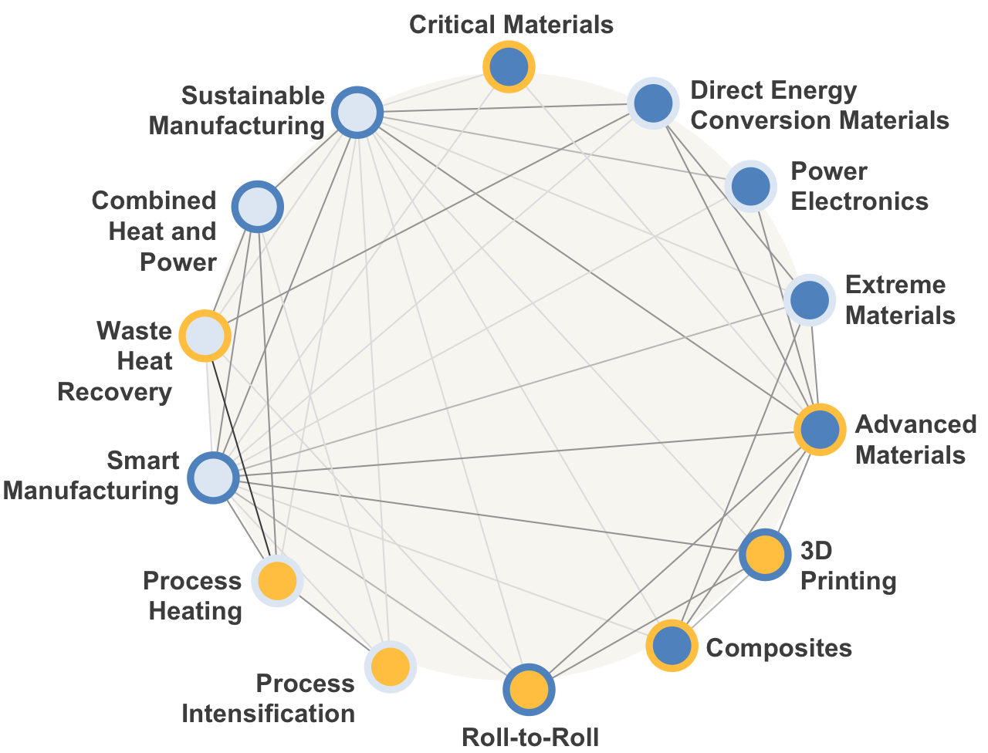
Another Angle
From DOE QTR

Slide 24
Energy Distribution
From: Paul Roege NDU Press, 2011

Slide 25
The merciful end

Slide 26

ADVANCED NUCLEAR CAMPAIGN
Todd Allen
Senior Fellow, Third Way
tallen@thirdway.org

Slide 27
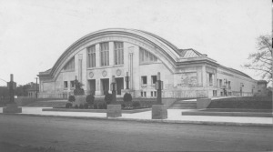
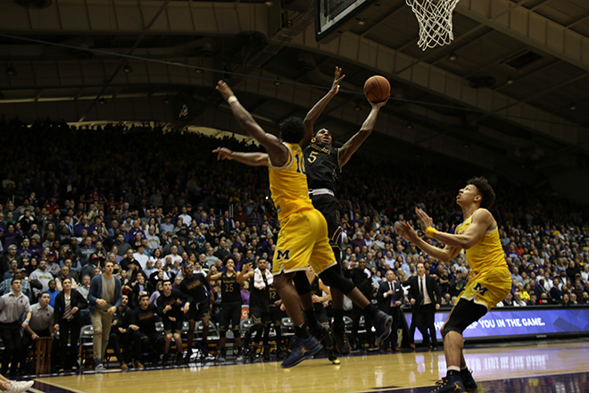
Finish with northwestern basketball?
Old Patten Gymnasium
Built 1909
First NCAA Basketball Championship 1939
Razed in 1940 to build Technological Institute
Derrick Pardon
Hits Buzzer Beater Against Michigan in 2017
Northwestern goes to NCAA tournament for the first time ever

Slide 28

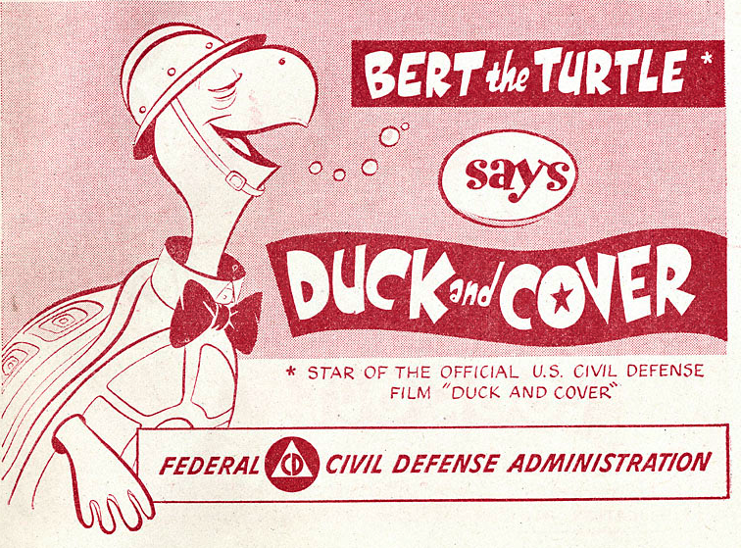

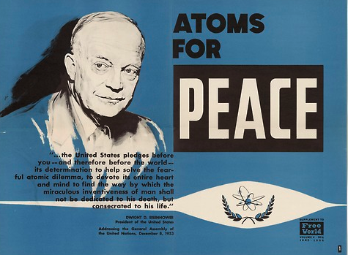
Early Messaging

Slide 29
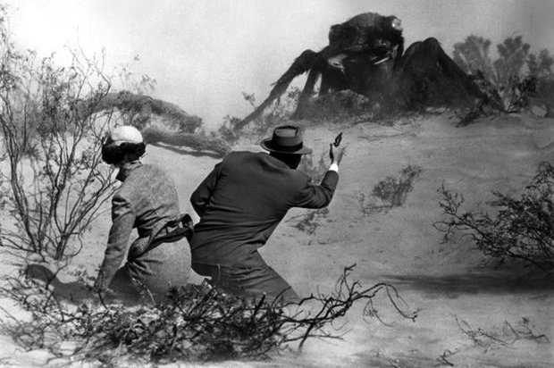

Them: Giant Mutant Ants (1950s)
A first entertainment use of radiation-induced mutant creatures

Slide 30
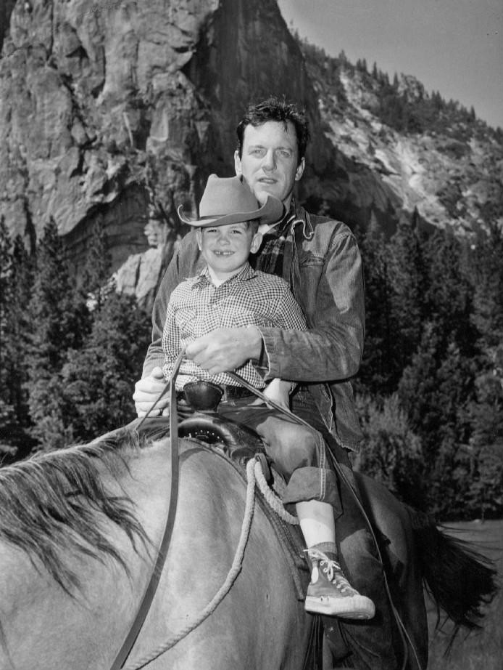

Back to James Arness

Slide 31
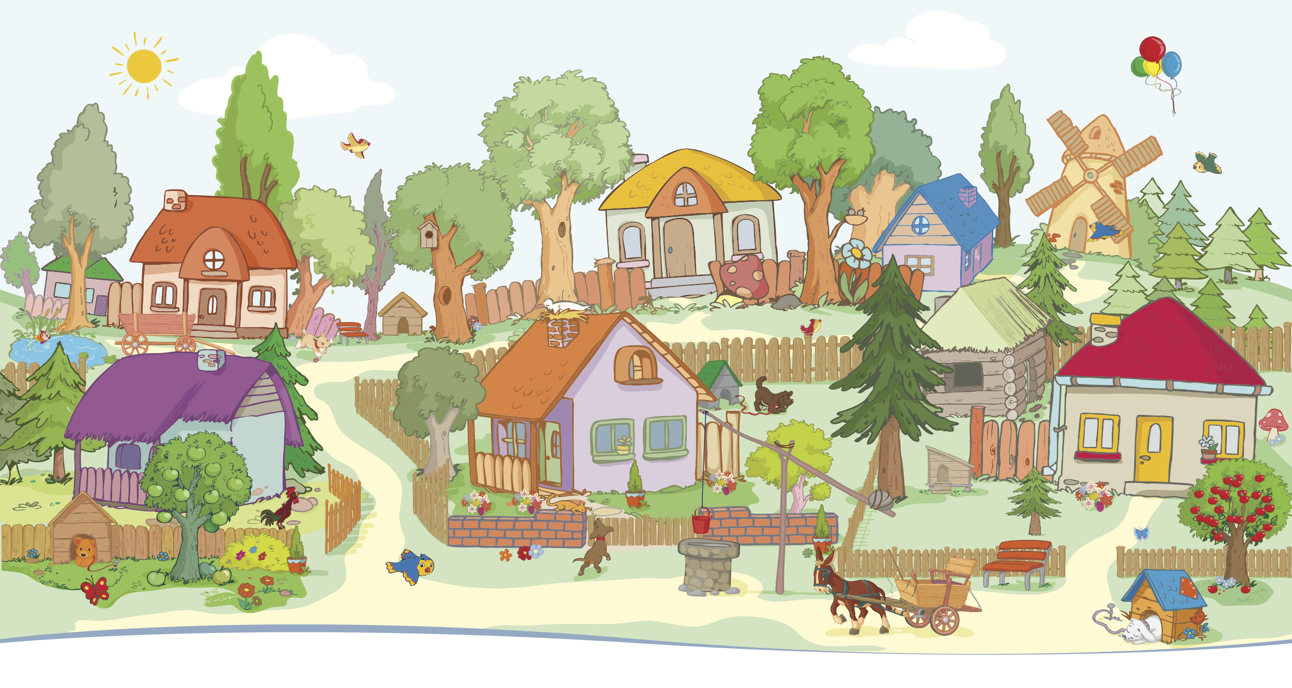
Back to James Arness
Why Nuclear in Africa? Why Not!
Joseph Odhiambo, Kenya Nuclear electricity board

Slide 32
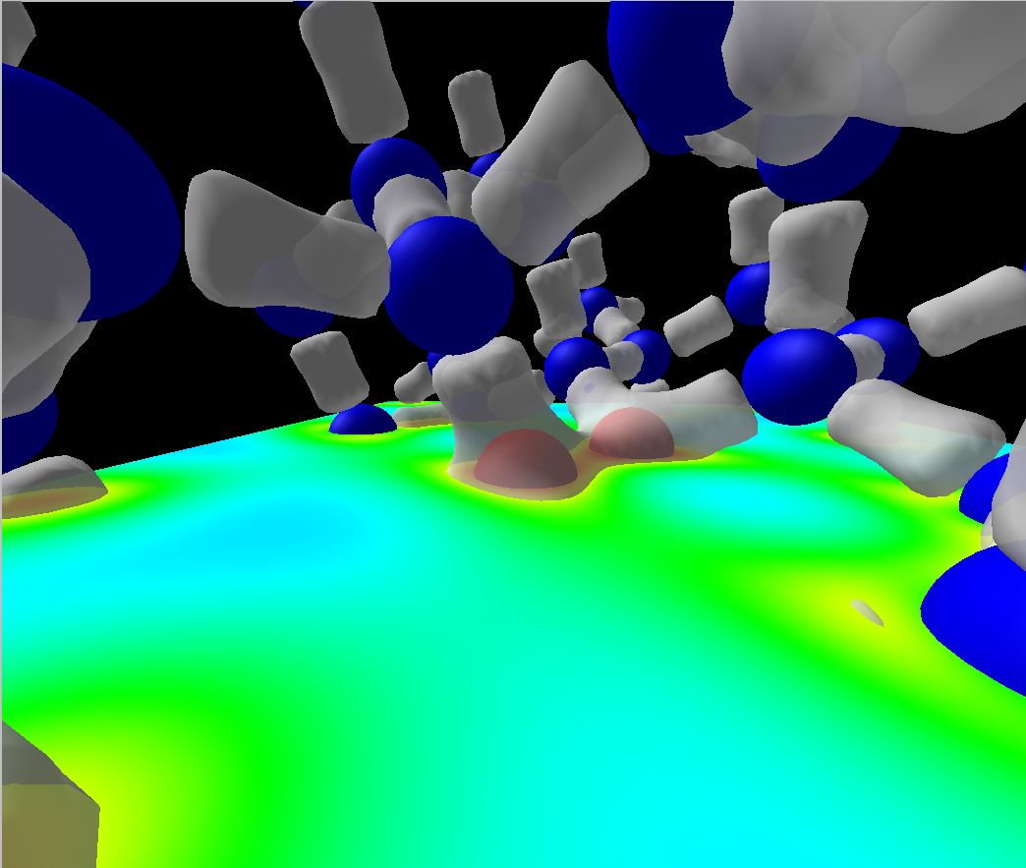
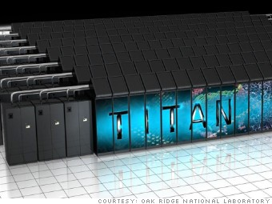

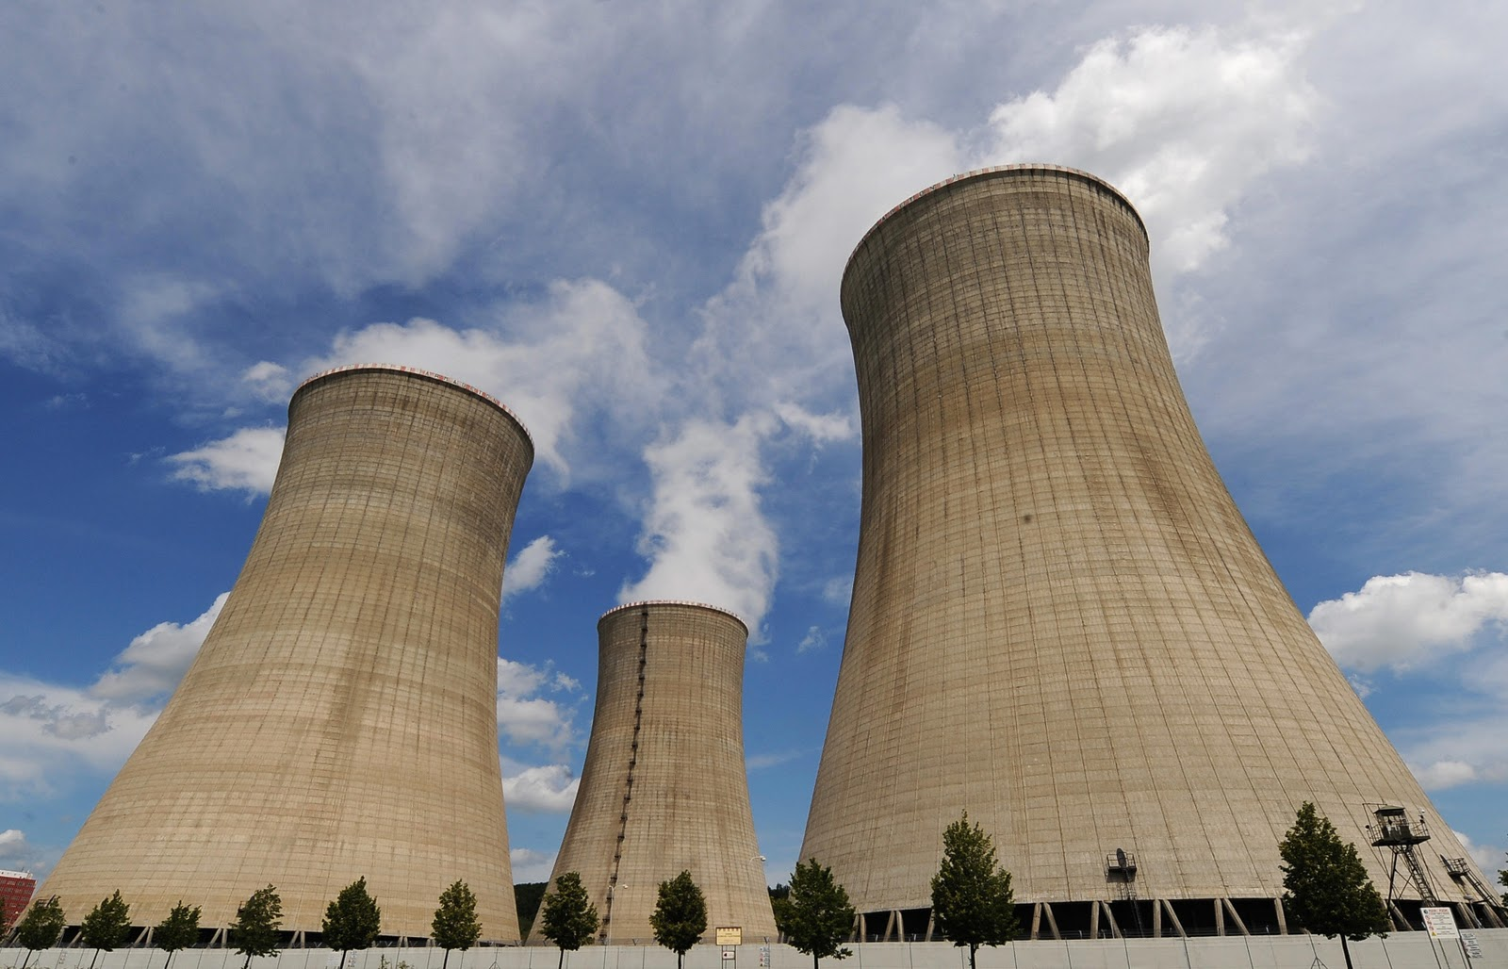
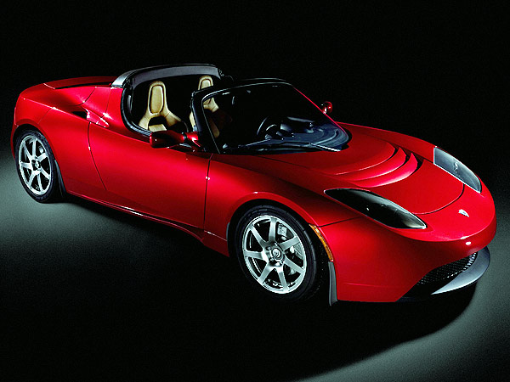
The Dream of Molecular Computational Materials Science
Atomic Understanding
Computation
+
Experiment
Understand, Optimize, Discover Materials
http://foreverfreshindoorgarden.wordpress.com/tag/compost-experiment/
Courtesy Prof Dane Morgan
http://www.teslasociety.com/nyautoshow.htm

