Slide 1
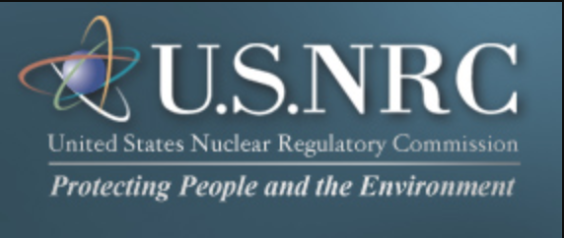
Nuclear Regulatory Commission
UW Madison
NE 231
Spring 2018

Slide 2
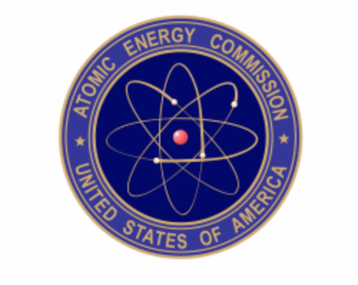
History
Nuclear regulation was the responsibility of the Atomic Energy Commission (AEC), which Congress first established in the Atomic Energy Act of 1946
Congress replaced that law with the Atomic Energy Act of 1954, which for the first time made the development of commercial nuclear power possible.
The act assigned the AEC the functions of both encouraging the use of nuclear power and regulating its safety.
The U.S. Nuclear Regulatory Commission (NRC) was created as an independent agency by Congress in 1974 to ensure the safe use of radioactive materials for beneficial civilian purposes while protecting people and the environment.
The NRC regulates commercial nuclear power plants and other uses of nuclear materials, such as in nuclear medicine, through licensing, inspection and enforcement of its requirements.
Notes:
The AEC's regulatory programs sought to ensure public health and safety from the hazards of nuclear power without imposing excessive requirements that would inhibit the growth of the industry. This was a difficult goal to achieve, especially in a new industry, and within a short time the AEC's programs stirred considerable controversy. An increasing number of critics during the 1960s charged that the AEC's regulations were insufficiently rigorous in several important areas, including radiation protection standards, reactor safety, plant siting, and environmental protection.
Today, the NRC's regulatory activities are focused on reactor safety oversight and reactor license renewal of existing plants, materials safety oversight and materials licensing for a variety of purposes, and waste management of both high-level waste and low-level waste. In addition, the NRC is preparing to evaluate new applications for nuclear plants. Several utilities have submitted applications for licenses to build new power reactors.
It licenses the construction of new nuclear reactors and regulates their operation on a continuing basis. It oversees the use, processing, handling, and disposal of nuclear materials and wastes, inspects nuclear-power plants and monitors both their safety procedures and their security measures, enforces compliance with established safety standards, and investigates nuclear accidents.

Slide 3
Governance
The NRC is headed by five Commissioners appointed by the President and confirmed by the Senate for five-year terms. One of them is designated by the President to be the Chairman and official spokesperson of the Commission.

Slide 4
Oversight
Oversees 99 commercial nuclear power reactors and 36 research and test reactors in the US.
Oversight is done on several levels. For example:
Each power-producing reactor site has resident inspectors, who monitor operations.
Numerous special inspection teams, with many different specialties, routinely conduct inspections at each site.

Slide 5
Regulations
NRC regulates reactor operations through a combination of:
regulatory requirements
licensing
safety oversight, including inspection, assessment of performance and enforcement
operational experience evaluation
regulatory support activities
Notes:
The NRC licenses all individuals who either operate or supervise the operation of the controls of a commercially owned nuclear power reactor or a test/research (i.e., non-power) reactor in the United States. Although the regulations in this area generally apply to both power and research and test reactors, this site focuses primarily on the operator licensing activities at power reactor facilities.

Slide 6
Licensing
Review of detailed engineering, safety and environmental information as well as extended public hearings for any changes or new proposals.
In recent years, the NRC has made an effort to expedite its procedures while still adhering to a strict regulatory framework.
NRC is currently looking into licensing non-LWR reactors
There are two methods by which a company may license their reactor: two-step licensing route or combined license route
Notes:
Power companies considering new capacity have been encouraged to make greater use of the NRC's combined construction and operating licence (COL) process, which had been in place since 1989 but not used until 2007. Companies can also apply for early site permits (ESPs), which allow them to apply for approval at a particular site before specifying the design of the reactor or to apply using one of the generic designs already certified by the NRC.
Initial operating licences for commercial power reactors are 40 years, but the NRC allows owners to apply for extensions of an additional 20 years. With the licences of many reactors built in the 1970s due to expire before 2020, the NRC has streamlined the process for renewal, concentrating on safety issues as opposed to other more procedural rules. Since 2000, the NRC has approved licence extensions for 73 reactors, with applications for a further 13 under review and applications for others expected by 2013.
In addition to the licensing and safety oversight of reactors, the NRC has regulatory authority over uranium mines and mills in some states, conversion and enrichment facilities, waste sites and all non-defence nuclear research laboratories (including those owned by the US Department of Energy)

Slide 7
Two-Step Licensing Process (10 CFR Part 50)
Applicant must submit a Safety Analysis Report. The NRC staff then reviews the application to determine whether the plant design meets all applicable regulations (10 CFR Parts 20, 50, 73, and 100).
When the NRC completes its review, it prepares a Safety Evaluation Report summarizing the anticipated effect of the proposed facility on public health and safety.
Advisory Committee on Reactor Safeguards (ACRS), an independent group that provides advice on reactor safety to the five-member Commission, reviews each application to construct or operate a nuclear power plant and once ACRS has completed its review, it submits the results in a report to the Commission via a letter to the Chairman of the NRC.
Notes:
Sar: This document contains the design information and criteria for the proposed reactor, and comprehensive data on the proposed site. It also discusses various hypothetical accident situations and the safety features of the plant that would prevent accidents or lessen their effects. In addition, the application must contain a comprehensive assessment of the environmental impact of the proposed plant. A prospective licensee also must submit information for antitrust reviews of the proposed plant.
in part:
characteristics of the site, including surrounding population, seismology, meteorology, geology and hydrology; design of the nuclear plant;
anticipated response of the plant to hypothetical accidents; plant operations including the applicant's technical qualifications to operate the plant;
discharges from the plant into the environment (i.e., radiological effluents); and
emergency plans.

Slide 8
Two Step Licensing
NRC staff also performs an environmental review to evaluate the potential environmental impacts and benefits of the proposed plant.
A public hearing be held before a construction permit is issued for a nuclear power plant. The public hearing is conducted by a three-member Atomic Safety and Licensing Board.
By the time the construction permit is issued, the applicant must have submitted a Final Safety Analysis Report to support its application for an operating license. This report describes the final design of the facility as well as its operational and emergency procedures.
The NRC prepares a Final Safety Evaluation report for the operating license, and the ACRS makes an independent evaluation and presents its advice to the Commission.
Notes:
The board is composed of one lawyer, who acts as chairperson, and two technically qualified persons. Members of the public may submit written or oral statements to the licensing board to be entered into the hearing record, or they may petition to intervene as full parties in the hearing.

Slide 9
Licensing
In 1989 the NRC established alternative licensing processes in 10 CFR Part 52 that included a combined license. This process combines a construction permit and an operating license with conditions for plant operation.
Other licensing options under Part 52 include Early Site Permits that allow an applicant to obtain approval for a reactor site without specifying the design of the reactor(s) that could be built there, and certified standard plant designs which can be used as pre-approved designs.
In either process, NRC approval is necessary before a nuclear power plant can be built and operated.
Notes:
In an effort to improve regulatory efficiency and add greater predictability to the process,
The NRC maintains oversight of the construction and operation of a facility throughout its lifetime to assure compliance with the Commission's regulations for the protection of public health and safety, the common defense and security, and the environment.

Slide 10
Combined License (10 CFR Part 52)
The new NRC licensing process provides for design certification, early site approval, and combined licensing for construction and operation.
A combined license authorizes construction of the facility much like a construction permit would under the two-step process (Part 50).
It must contain essentially the same information required in an application for an operating license issued under 10 CFR Part 50 and specify the inspections, tests, and analyses that the applicant must perform.
If the application does not reference an early site permit and design certification, then the NRC reviews the technical and environmental information as described for the two-step licensing process.
The steps are as follows…
Notes:
10 CFR Part 52 of NRC regulations provides for issuance of a combined construction permit and operating license, also known as a combined operating license (COL). A COL may reference a certified design, an ESP or both.
The new NRC licensing process provides for design certification, early site approval and combined licensing for construction and operation.

Slide 11
Combined License - Design certification
Design certification allows plant designers to secure advance NRC approval of standard plant designs. Later, these plant designs can be ordered, licensed for a particular site and built.
The application presents the design basis, the limits on operation, and a safety analysis of structures, systems, and components of the facility as a whole.
The scope and contents of the application are equivalent to the level of detail found in a Final Safety Analysis Report for a currently operating plant.
The NRC staff prepares a Safety Evaluation Report that describes its review of the plant design and how the design meets applicable regulations.
Notes:
Design certification allows plant designers to secure advance NRC approval of standard plant designs. Later, these plant designs can be ordered, licensed for a particular site and built.

Slide 12
Combined License - Design certification
This process allows the public to review and comment on the designs up front—before any construction begins.
The NRC approves the design for 15 years.
Once a design certification application has been submitted, the NRC takes between 36 and 60-plus months to complete the review and rulemaking.

Slide 13
Design Certification Benefits
Design standardization offers significant benefits.
The approach anticipates that reactors will be built in families of the same design, except for a limited number of site-specific differences.
Standardization will reduce construction and operating cost, and lead to greater efficiencies and simplicity in nuclear plant operations, including safety, maintenance, training and spare-parts procurement.
Standardization is a major departure from the first generation of U.S. nuclear reactors, which are nearly one-of-a-kind.

Slide 14
NRC has issued the following design certifications
Source: https://www.nrc.gov/reactors/new-reactors/design-cert.html

Slide 15
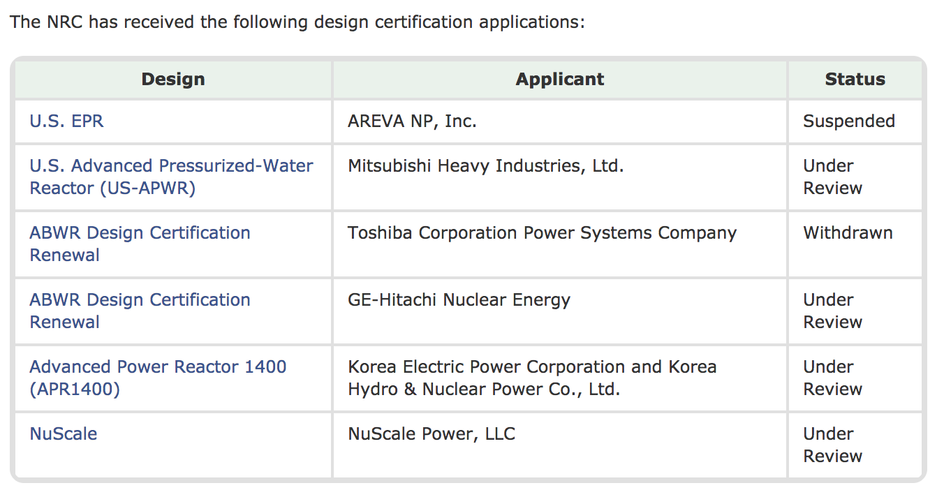
NRC has received the following Design Certification Applications
Source: https://www.nrc.gov/reactors/new-reactors/design-cert.html

Slide 16
Combined License - Early site permit
The process enables companies to obtain approval from the NRC for a nuclear power plant site before deciding to build a plant.
The process resolves any site suitability issues before companies commit funds to a project.
Companies can “bank” sites approved by the NRC for up to 20 years and build when the time is right.
ESP applications consist of three components: a site safety analysis, an environmental report and emergency planning information. Federal, state and local government officials and the public have opportunities to participate in each of these
Notes:
Having a preapproved site can dramatically shorten the time to bring a new plant to market. However, the NRC does not require an applicant for a new-plant license to obtain an ESP.

Slide 17
Combined License - Early site permit
An ESP review process that encompasses a range of reactor designs enables companies to select the best design when they proceed with a decision to build.
Through the use of the “plant parameters envelope” concept, the NRC can assess the suitability of a site based on a generalized plant description that takes into account the characteristics of several designs
It takes between 12 and 24 months to develop an ESP application, depending on whether it is a “greenfield” site or a site adjacent to an existing facility. Once the applicant submits the application, the process of NRC review and approval—including the public hearing—takes approximately 33 months.
Notes:
Having a preapproved site can dramatically shorten the time to bring a new plant to market. However, the NRC does not require an applicant for a new-plant license to obtain an ESP.

Slide 18
Combined License
10 CFR Part 52 of NRC regulations provides for issuance of a combined construction permit and operating license, also known as a combined operating license (COL).
A COL may reference a certified design, an ESP or both.
This makes the process more effective and efficient by allowing the NRC review and a public COL hearing to focus on remaining issues related to plant ownership, design issues not resolved earlier, and organization and operational programs.
Granting a COL signifies resolution of all safety issues associated with the plant.

Slide 19
Industry-Led Licensing Modernization Project
The NRC historically only has capabilities to license large LWR designs but there are many efforts to expedite and improve the licensing process for advanced LWR and non-LWR designs
The NRC is supporting activities related to the Licensing Modernization Project (LMP) being led by Southern Company, coordinated by NEI, and cost-shared by DOE.
The LMP's objective is to develop technology-inclusive, risk-informed, and performance based regulatory guidance for licensing non-LWRs for NRC to review and potentially endorse.
The NRC is currently reviewing four LMP white papers:
Selection of Licensing Basis Events, Draft Report
Probabilistic Risk Assessment Approach
Safety Classification and Performance Criteria for Structures, Systems, and Components
Risk-Informed and Performance-Based Evaluation of Defense-in-Depth Adequacy.

Slide 20
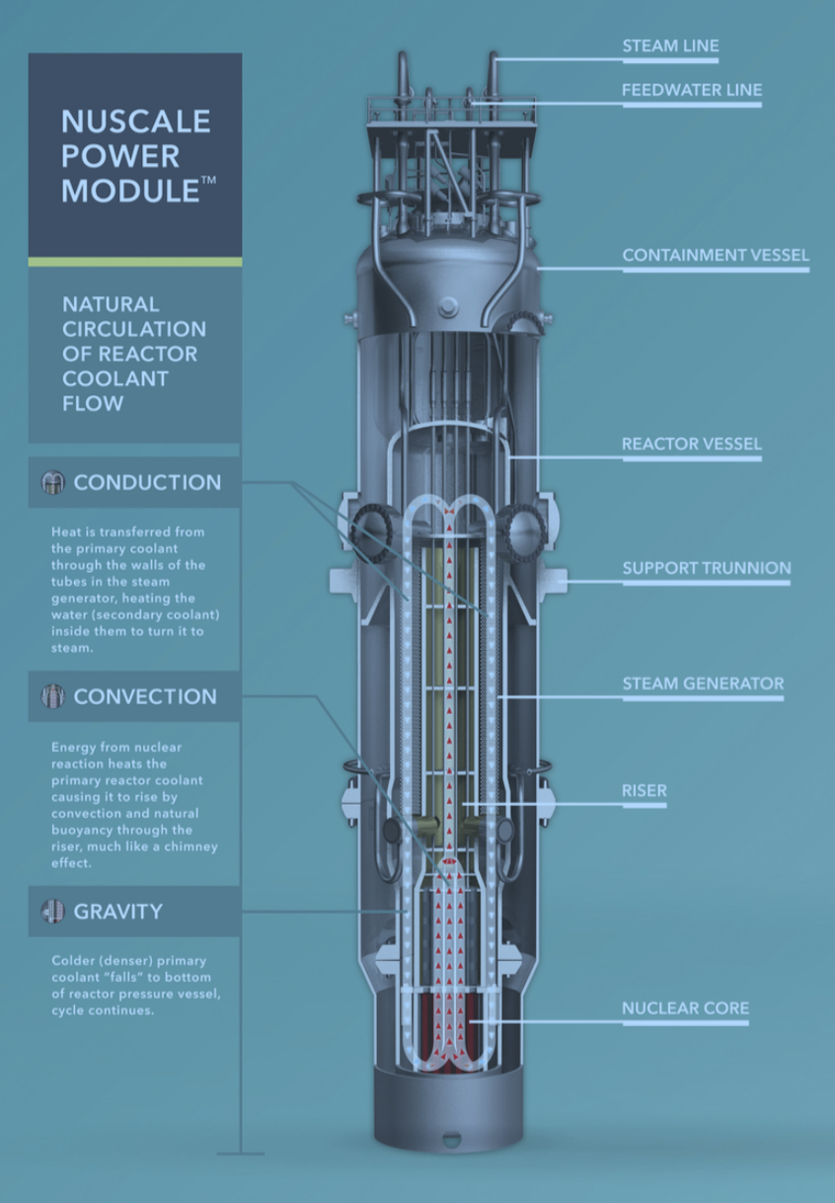
Case Study: NuScale
Pioneer in pre-application NRC engagement, having begun the process in July 2008.
NuScale made over 80 presentations and submitted 15 topical reports to the NRC—engaging the NRC on topics such as safety analysis, nuclear fuel, test programs, seismic analysis, and control room staffing.

Slide 21
Case Study: NuScale
On December 31st, 2016, NuScale submitted the first ever Small Modular Reactor (SMR) Design Certification Application (DCA) to the NRC
NuScale’s application consisted of 12,000 pages of technical information.
The NRC has targeted completing the certification process within 40 months.

Slide 22
Case Study: NuScale
While the DCA review process is underway, NuScale expects one or more applicants to file a combined construction and operation license application (COLA) in 2019, allowing the DCA and COLA review processes to proceed on parallel paths.
The design ultimately certified by the NRC will be incorporated in each of the COL’s.
Regulatory procedures and timeline:
Licensing – NRC must issue an approved DCA and COL prior to construction. With the DCA submitted in December 2016, a submission of a COL Application by NuScale’s first customer(s) is expected in 2019.
Initial Operations - NuScale forecasts the first NPM will go into operation in 2026.

Slide 23
Questions?

