Slide 1
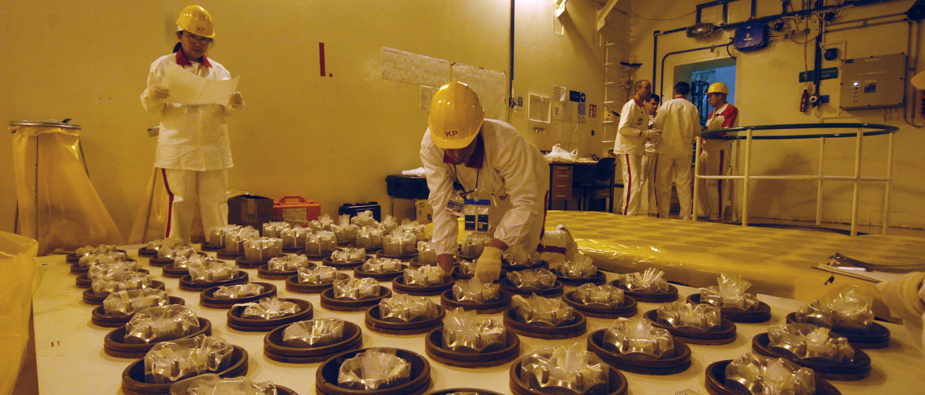
International Safeguards
NE 231
Spring 2018

Slide 2
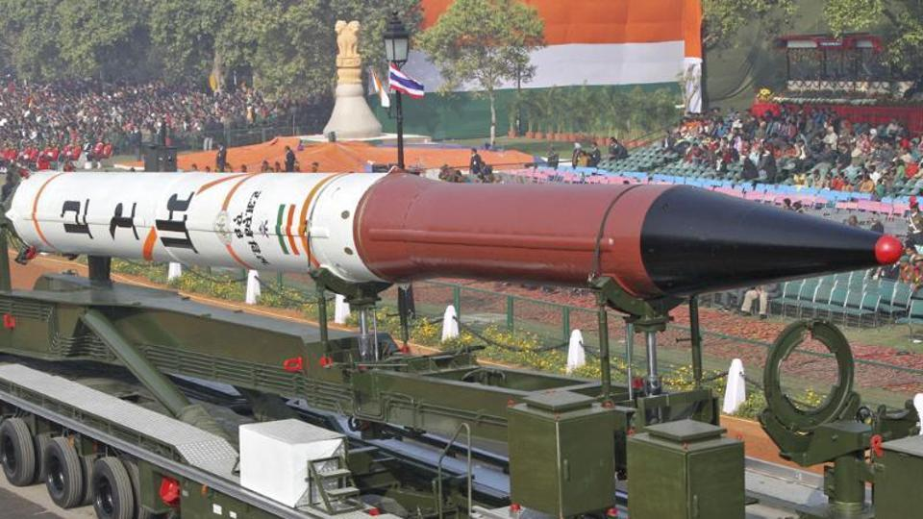
Overview: Nuclear Safeguards
Verification that a state is not using civil nuclear technology for weapons development (e.g. enrichment, reprocessing)
The International Atomic Energy Agency (IAEA) inspects nuclear facilities that participate in non-proliferation initiatives
Most countries are voluntarily enrolled in non-proliferation initiatives and have been since 1970
Countries have diplomatic and economic incentives to participate
Agni 4 Missile (New Delhi, India)

Slide 3
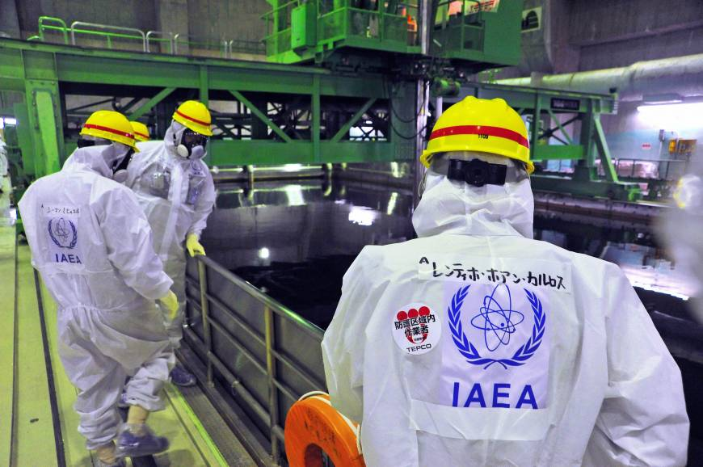
IAEA Inspections
Material accountancy: inspectors verify that a state has only what nuclear materials it claims to have
Safeguards technology:
Seals
Surveillance systems
Physical security
Inspections happen routinely, or by surprise (with cause)
Inspectors are hired from all over the world and work a limited number of years
IAEA Inspectors (Fukushima, Japan)

Slide 4
Significant Quantities
Significant quantity (SQ): the approximate amount of nuclear material for which the possibility of manufacturing a nuclear explosive device cannot be excluded. Significant quantities take into account unavoidable losses due to conversion and manufacturing processes and should not be confused with critical masses. Significant quantities are used in establishing the quantity component of the IAEA inspection goal.
Notes:
U-233 is bred from neutron irradiation of Thorium. U-233 is fissile, similar utility to Pu-239 in nuclear weapons.

Slide 5
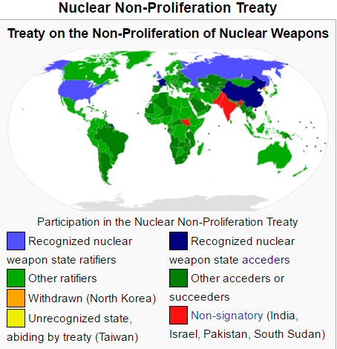
Nuclear Non-Proliferation Treaty (1970)
Goals:
Promote peaceful uses of nuclear technology
Prevent spread of nuclear weapons technology
Central bargain:
Non-nuclear weapon states will never acquire nuclear weapons
Nuclear-weapon states will share the benefits of peaceful nuclear technology and pursue nuclear disarmament to eliminate nuclear arsenals

Slide 6
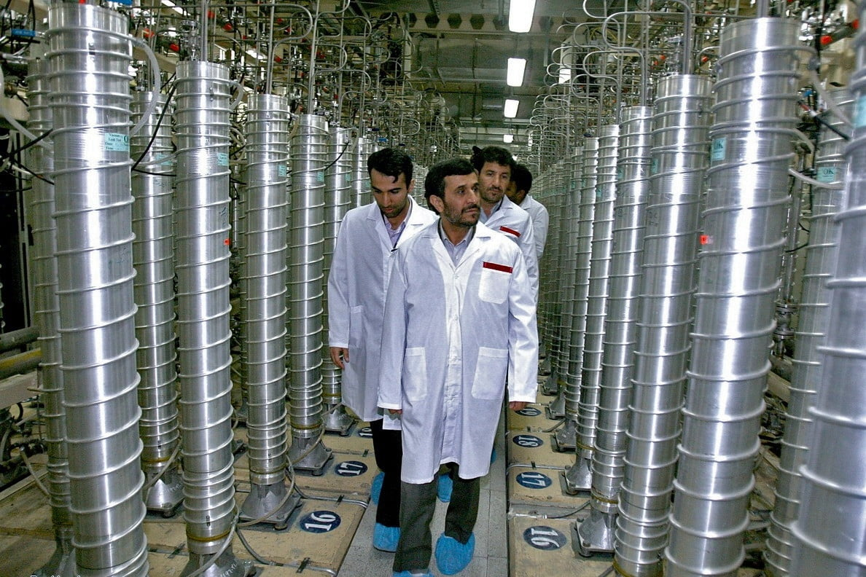
NPT Pillar #1: Non-Proliferation
Nuclear-weapons states can’t transfer nuclear weapon technology or help non-nuclear weapon states build weapons
Non-nuclear weapons states can’t acquire nuclear weapons, and they accept IAEA safeguards inspections
Centrifuge Enrichment Facility (Iran)

Slide 7
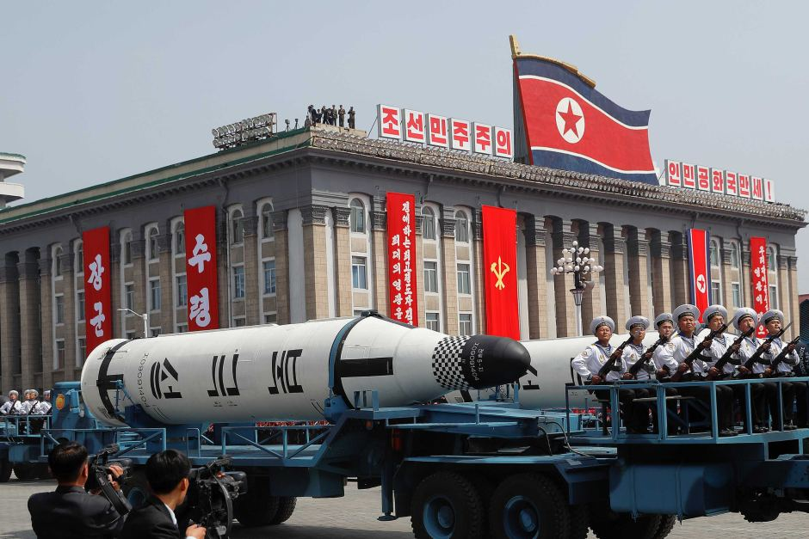
NPT Pillar #2: Disarmament
Nuclear weapons states undertake “good-faith negotiations” to reduce nuclear arsenals
No specific requirements or timelines for reducing nuclear arsenals
USA and Russia have been trying to negotiate disarmament since before the NPT was entered (SALT I, SALT II, SORT)
Military Parade (Pyongyang, North Korea)

Slide 8
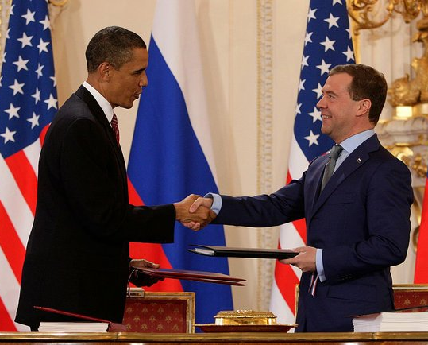
Progress for Disarmament
Recent US-Russia Treaties:
Plutonium Management and Disposition Agreement (2000)
Convert non-essential Pu into MOX fuel for reactors
Convert 34 tons of Pu each (17,000 nuclear weapons combined)
Russia successfully operated MOX plant, US had funding and technical problems
Russia suspended the treaty due to US failure to comply
New START (2011)
Limit of 1,550 deployed nuclear warheads each
Must have achieved this by 2018
Numbers currently fluctuate around 1,550
US and Russian presidents Obama and Medvedev after signing New START

Slide 9
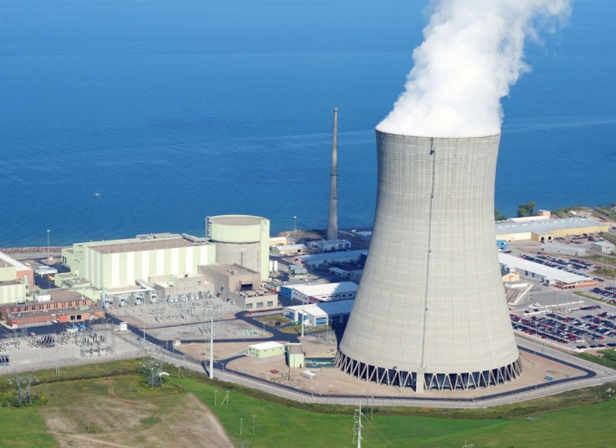
NPT Pillar #3: Peaceful Use of Nuclear Energy
All NPT parties have a right to develop and transfer peaceful nuclear power technology
Includes enrichment and reprocessing, but there are limits and IAEA inspections are necessary

Slide 10
Non-Signatories
India:
Believes the NPT is discriminatory
Had a “no first use policy”, but shifted to “no first use against non-nuclear states”
Some of their reactors comply with IAEA safeguards / imports from the US
Pakistan:
Pakistan conducted first nuclear test in 1998, after India
Pakistan believes it has the right to defend itself
Estimates are that they have up to 120 warheads.
Israel:
Strategic ambiguity. Estimates that they have up to 400 warheads.
North Korea:
Originally signed the treaty, started enriching uranium, then withdrew.

Slide 11
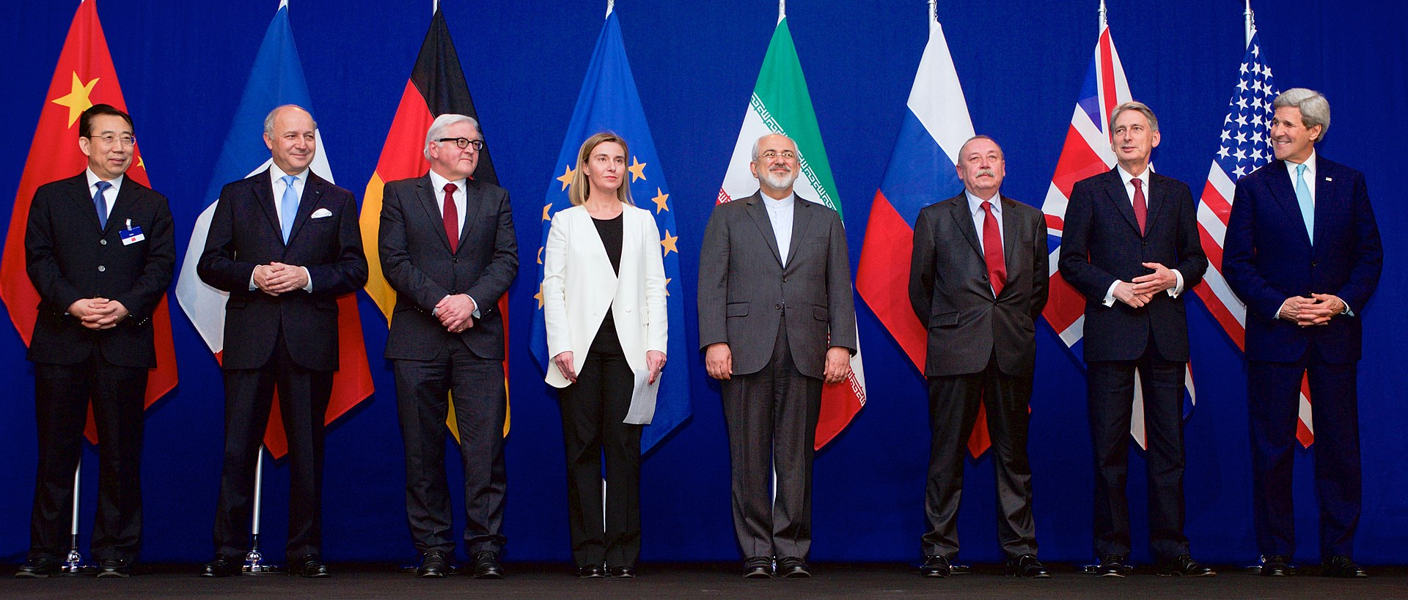
Iran Nuclear Deal
Iran signed the NPT, but was found in non-compliance by the IAEA for concealing an enrichment program in 2003
Iran insisted on keeping its enrichment program for energy independence
The IAEA reported Iran the UN who ordered them to suspend enrichment, and imposed sanctions when they refused
At the outset of negotiations, it was estimated that Iran could have had sufficient material for a nuclear weapon in about two weeks

Slide 12
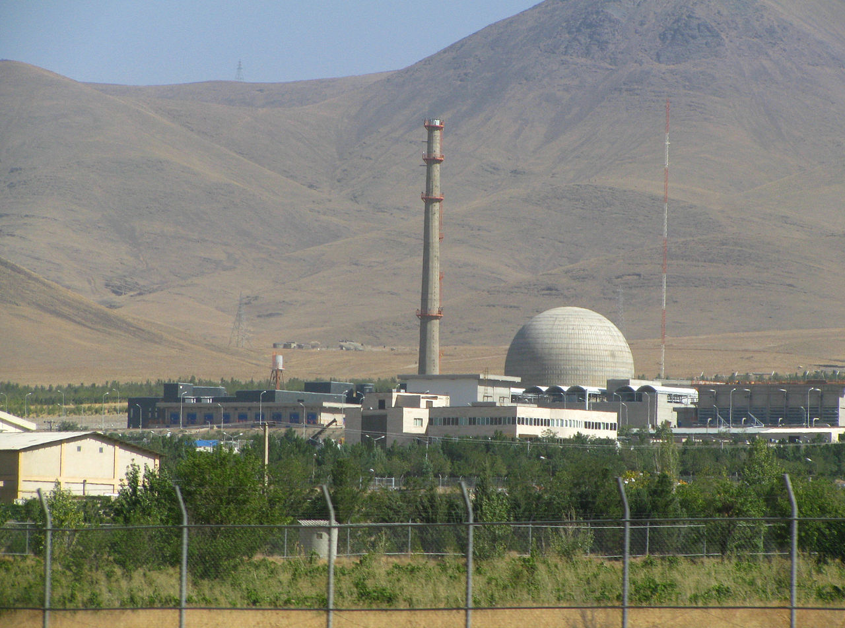
Iran Nuclear Deal
Reduce centrifuges from 19,000 to 6,104
Enrich only to 3.67% (reactor grade)
Reduce stockpile from 10,000 to 300 kilograms of LEU
ARAK reactor will remain heavy water but the core has been redesigned to produce minimal plutonium
IAEA inspection of al nuclear facilities and supply chains
Arak Heavy Water Reactor (Iran)

Slide 13
Discussion Questions
Does the NPT favor weapons states?
Is disarmament or deterrence more effective at preventing nuclear war?
Marginal Utility: as the number of nuclear weapons decreases, the utility of having one nuclear weapon increases.

